Slide 1
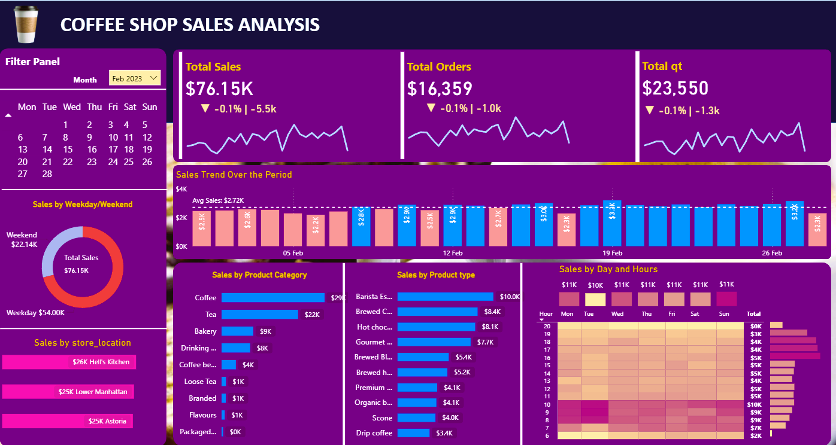
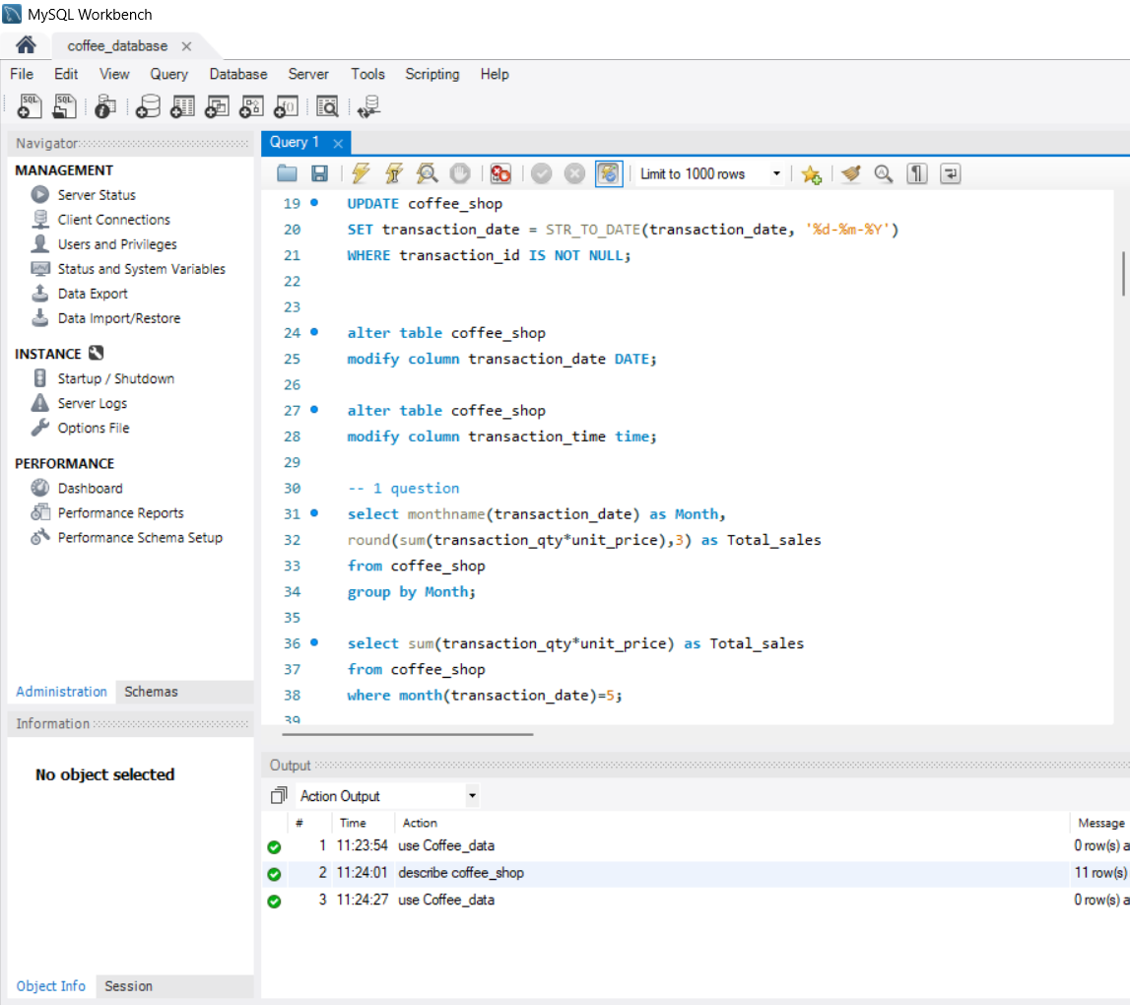
Coffee Shop Sales Analysis MySql and Power BI Project

Slide 2

PURPOSE OF PROJECT
The purpose of this project is to analyze coffee shop sales data to identify trends, customer behavior, and business performance. By examining sales, orders, products, and store locations, the project aims to generate actionable insights that support decision-making, improve efficiency, and enhance overall sales strategy.

Slide 3
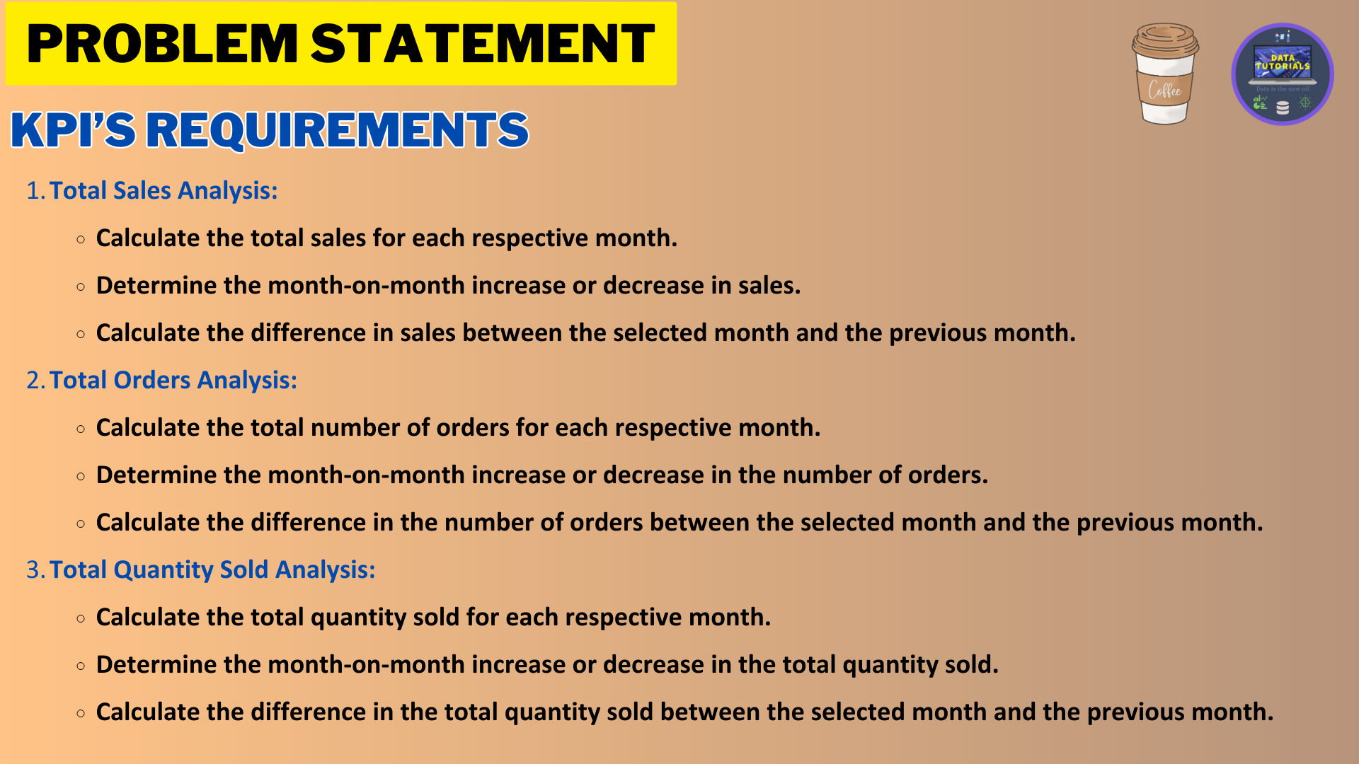

Slide 4
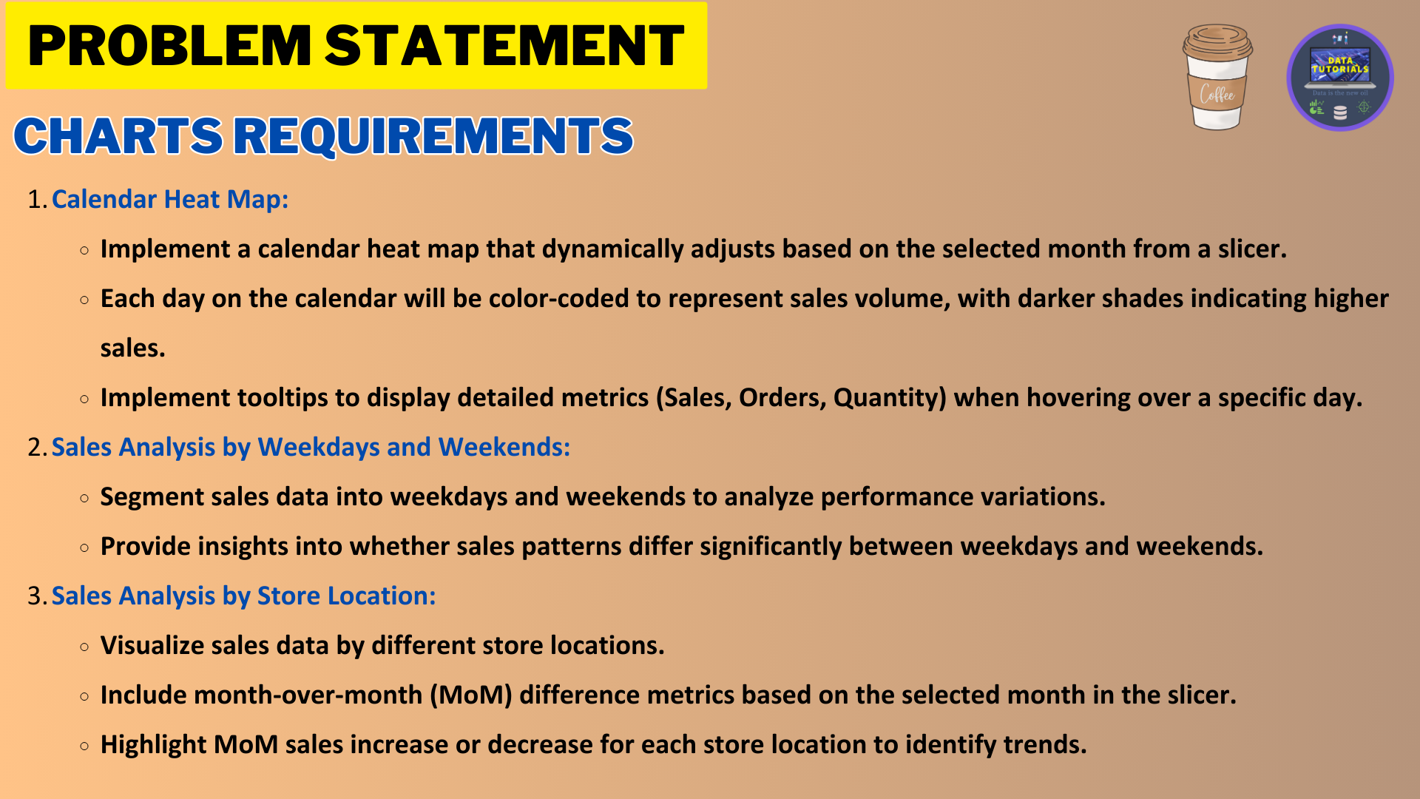

Slide 5
